Slide 1
Optimist International
June 30th, Reno, Nevada
New Opportunities
Notes:
Gwen

Slide 2
WHY
POURQUOI
POR QUÉ
Notes:
Linda - WITH FLIP CHART

Slide 3
WHAT
Quel
Que
Notes:
Julie

Slide 4
WHERE
OÙ
DONDE
Notes:
Lynn

Slide 5
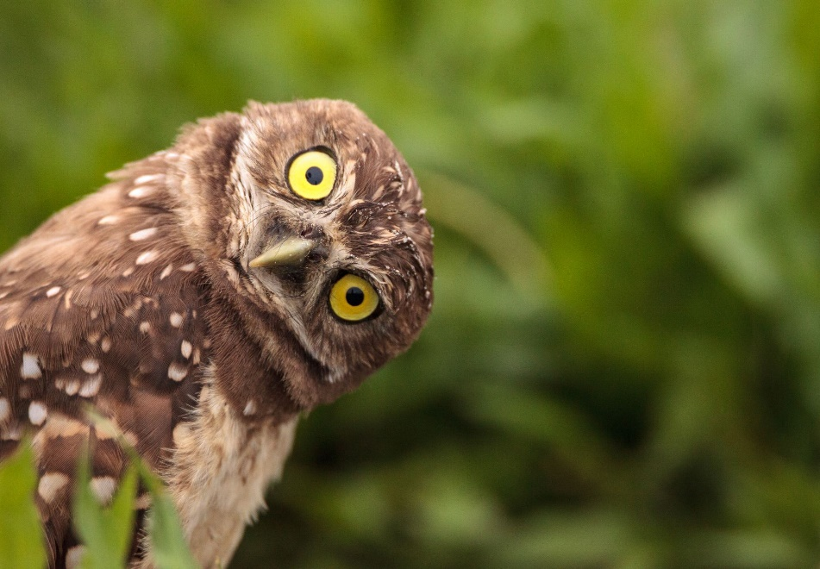
WHO
Quien
Qui
Notes:
Linda

Slide 6
WHEN
Quand
Cuando
Notes:
Donna

Slide 7
HOW
?
?
Como
?
?
?
Comment
Notes:
Rod

Slide 8
It’s a TEAM Effort!
You are not alone!
Create a strong working team
Build a plan
Be strategic
Celebrate success
Notes:
Gwen

Slide 9
Create a Strong Working Team
District Governor
Lieutenant Governors
District Builders of Excellence
Certified New Club Builders
Notes:
Gwen

Slide 10
Building Blocks for Success
Our Creed
Mission Statement
Mentorship Program
Marketing
Social Media
Notes:
Julie

Slide 11
Build a Plan Now
Commit to doing your first build in the 1st quarter
Pick your location
Pick your building lead
Set your plan
Do regular follow-ups
Notes:
Lynn

Slide 12
Take Action Now
Identify locations you want to build
Identify others to work with you
Identify the timeframe for the build
Set a plan for 6 to 8 weeks for the build
Get a core group
Communicate consistently
Make each contact
count
Notes:
Donna

Slide 13
Let’s Make It Happen
We can’t succeed without you
We need you to lead your District teams
Get involved – show that you care
Lead by example
Let’s make this the best New Club Building year ever
Notes:
Gwen and Rod

Slide 14
New Club Building
Our Goal
125 new Optimist Clubs in Canada, United States and the Caribbean
Why?
43 Districts X 3 = 129 new clubs
125 is a reasonable, attainable goal
Our organization needs to start growing to be sustainable in the future
Notes:
Rod

Slide 15
Optimist International
Available Resources:
International New Club Building Committee
Jim Boyd, Director of Strategic Growth
Governor
Vice President
Notes:
Comments/Questions

