Slide 1
Club Presidents-Elect
Resources for Success

Slide 2
Objectives of Seminar
Acquire a better knowledge of President’s role and function
Learn effective ways to lead volunteers, conduct meetings and grow your club
Crucial Conversation
Notes:
Also: To teach the Club President the skills they need to lead their clubs to a successful year.

Slide 3
Accepting the Challenge
Club President is the
Chief Executive Officer
in the “People Business”
of motivating and
managing the efforts
of volunteers.

Slide 4
Brainstorming
List the characteristics of a good leader
Which are most important?
Notes:
Brainstorm the characteristics of a good Club leader. List them on a flip chart.
Discuss and put a star next to the ones the group feels are most important for the success of the Club.
ANSWERS ARE ON NEXT SLIDE: They include:
be:
Committed Friendly
Optimistic Delegate
Smile Promote Fellowship
Good Listener Tactful
Appreciative Recognize effort
Persistent Organized
Dependable a good public speaker
Care

Slide 5
Possible Answers
Commitment
Friendly
Optimistic
Delegate
Smile
Promote Fellowship
Good Listener
Tactful
Appreciative
Recognize effort
Persistence
Organized
Dependable
Speaking ability
Caring
Notes:
NOET: Did they get them all, or did they add any more?

Slide 6
Resources for Success
Who are your “Resources”?
Notes:
ANSWERS to Next Slide are:
People
Governor Lieutenant Governor
District Committees Mentor
Websites
optimist.org
Publications
Awards Handbook Bylaws
Leadership Hotline Optimist Magazine
See Web-sites
Conferences
Zone Meetings
District (4)
International Convention (July)

Slide 7
Resources for Success
People
Governor
Lieutenant Governor
District Committees
Mentor
Websites
optimist.org
Publications
Awards Handbook
Bylaws
Leadership Hotline
Optimist Magazine
See Web-sites
Conferences
District (4)
International Convention (July)
Notes:
NOTE: The lt Gov is to assist the Clubs in the Zone and to help them suscced. The Lt. Gov will have official contac with the Club through:
Installation of incoming officers
Monitoring the Honor Club Tracking Form
Four quarterly Zone meetings, or what is asked of their District.
A Mid-year club visitation.
District Committee: ASK: What help can the District Committees give to your club?
Additional Resources:
Club By-Law
District By-Laws
New Club Building Handbook
Videos and audio types
Skills Development Modules
Optimist International Web Page
Websites: Also if looking for ideas of other clubs, search out other optimist clubs Websites or other District websites.

Slide 8
Governance of Optimist International
Optimist International Board & President
Staff in St. Louis & Montreal
Regional Vice Presidents
District Governor, Executive Committee & Board
Zone Lieutenant Governors
Club President & Board
Member Volunteers

Slide 9
Finances
Youth Fund
Monies raised from the community are returned to the community
General Fund
Dues pay for internal social, and administrative costs
Fiscal year October 1 - September 30
Notes:
General Fund may also pay for members attendance at District meetings as it can be considered “educational”.

Slide 10
Budget
Created during Summer for upcoming year (Oct. 1- Sept. 30)
By Club Finance Committee including Secretary/Treasurer Designate and President Elect
Budget Guides available on optimist.org
Notes:
Budget Guidelines are at:
www.Optimist.org
Member Resources
Forms, Documents & Publications
Documents
Club Documents
Club Budget and Finances
Page 4 Model Club Budget
Page 5 Disbursements

Slide 11
Incorporation
Autonomous not-for-profit youth service organization - Incorporation in U.S. usually under 501(C)(4)
Dues may be a business expense but not a “charitable contributions”
501(C)(3) is a Foundation
Notes:
NOTE: Be sure to check with your Secretary of State to see if your club is current and in Good Standing.
Not all states need to file with their State’s Secretary of State. And, it is a possibility that your Accountant may be filing this.

Slide 12
OI Foundation
OIF – U.S. Foundation
CCOF – Canadian Foundation
Donations to support Youth Work
oifoundation.org / ccof-foec.org

Slide 13
Fundraising
Best Fund Raisers are:
High Income
Low Investment
Minimal Risk
Build Member Morale
Maximize Club Name Recognition
Fund-Raising Projects – See www.optimist.org
Notes:
Fundraising Projects can be found at www.optimist.org
Key Resources
Optimist Resource Library
Outstanding Club Projects
Fundraising Projects (Not Yet Available)

Slide 14
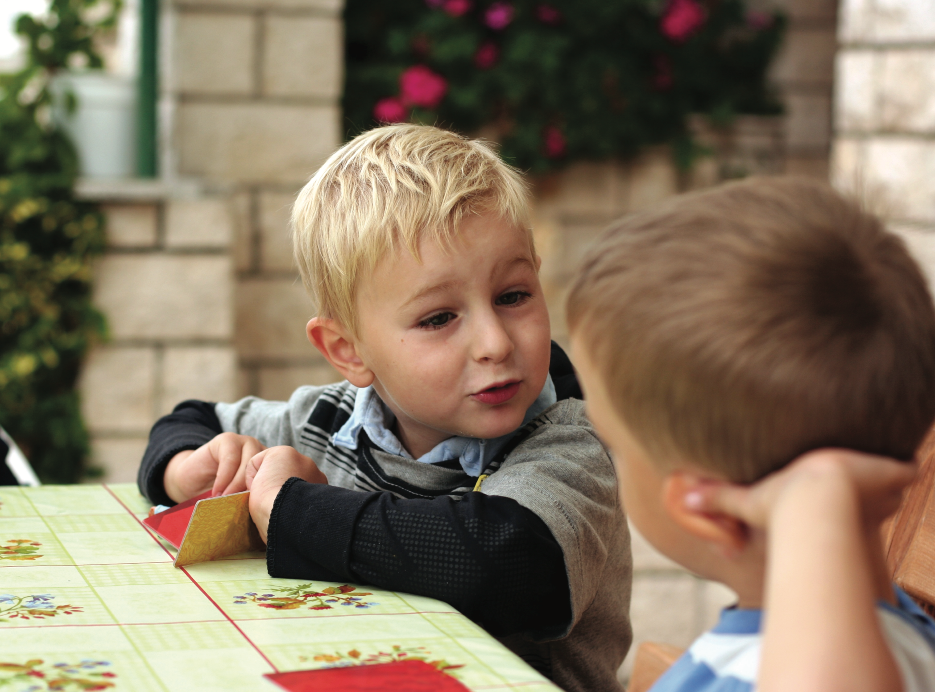
Notes:
Nothing special – Just love this photo of kids communicating.

Slide 15
Quiz Bowl
Who is considered the “Chief Executive Officer” of an Optimist Club?
Notes:
ANSWER: Club President

Slide 16
Quiz Bowl
Who sets the policy and direction for an Optimist Club?
Notes:
ANSWER: Board of Directors

Slide 17
Quiz Bowl
Who raises Member’s dues to belong to an Optimist Club?
Notes:
ANSWER: A vote of the general membership of the Club.

Slide 18
Quiz Bowl
Who is the current President of Optimist International?
Notes:
ASK: Who is the current President of Optimist International?
ASK: Who is the President-Elect of Optimist International?
ASK: What is the name of your District Governor-Elect
ASK: What is the name of your District Secretary-Treasurer-Designate?

Slide 19
Quiz Bowl
Which member of your Club’s Board of Directors is not elected?
Notes:
ANSWER: Secretary-Treasurer is appointed by President and approved by the Board.
ASK: What is the official Optimist International branding statement? ANSWER: Optimist bring out the best in youth, our communities and ourselves.
ASK: When does the Optimist year begin? ANSWER: October 1st.

Slide 20
Quiz Bowl
By what date should a Club elect new Officers?
Notes:
ANSWER: Before April 30th
ASK: Who presides at a Club meeting if the President is absent? ANSWER: Vice President
ASK: Who is considered the right arm of the Club President? ANSWER: Secretary-Treasurer

Slide 21
Quiz Bowl
What is the name of the form to report the addition of new members?
Notes:
ANSWER: Club Roster Adjustment (CRA) Form
ASK: How often should a Club Secretary-Treasurer present a financial report to the Club Board of Directors? ANSWER: Monthly

Slide 22
Quiz Bowl
What is the non-profit status under which most U.S. clubs are incorporated?
Notes:
ANSWER: 501(C) 4
Can be found at:
Member Resources
Forms, Documents and Publications
Documents
Club Documents
Tax Exempt Letter stating 501(c) 4

Slide 23
Quiz Bowl
In what city is the next Optimist International Convention?
Notes:
ASK: In what city is the next Optimist International Convention?
ASK: Who is the Executive Director of Optimist International?
ASK: What is the name of the document that defines our organization? ANSWER: By-Laws
ASK: Who can change our By-Laws? ANSWER: Club delegates at International Convention
ASK: What is our official creed? ANSWER: The Optimist Creed.

Slide 24
Up Next
Leading Your Team
BREAK

