Slide 1
New Club Building
Your roadmap to building a new club
  Building a new club is greatest commitment, offering the greatest challenge and it returns the greatest reward.
Version 22.10.01.3
Notes:
(version denotes year.month.version.edited this document was created by the marketing & communication for the New Club Building Committee)

Slide 2


Research & Discovery
Plan & Recruit
Inform & Organize
Follow-Up
Notes:
It’s easier to travel down the road when you have a roadmap to follow…

Slide 3
Starting a New Club
There is more than one way to build a Club

Slide 4

One of the MOST fulfilling projects you and your Club will ever do.
You’ve decided to build a New Club, now what?
Once your Club has decided to Sponsor a new Optimist Club, please file the New Club Sponsor Commitment Form. click here
Tell everyone and get support
You’ll need to also notify your
District New Club Building Chair and
District Governor, who in turn will
notify the Optimist International
New Club Building Committee.
Regular progress reports will also
be submitted. Click here
In this presentation you will find resources to assist you to be successful.
Notes:
Traditional Club – A traditional Optimist Club conducts a number of exciting, youth-oriented events and fund raisers each year. The Club meets on a regular basis at a fixed location.
Sports Club – A Sports Club is built with the primary goal to serve youth through athletics.
College Club - A College Club is built around a college or university and is primarily made up of college students interested in service, leadership and professional development. A special dues and fees structure applies.
Special Needs/Adults with Exceptionalities Club-The membership for this type of Club focuses on the segment of society that has intellectual or developmental disabilities. The membership roster must be comprised of at least 50 percent of the members from this segment of the population. A special dues and fees structure applies
Overseas Clubs – These clubs are much the same as a traditional Club but carry a special dues and fees structure.

Slide 5
Types of Club
Traditional Club
  These clubs meet on a regular basis. They conduct several exciting youth-oriented events and fundraisers.
Sports Club
  The primary goal is to serve youth through athletics.
College Club
  College students interested in service, leadership, and professional development.
Notes:
Traditional Club – A traditional Optimist Club conducts a number of exciting, youth-oriented events and fund raisers each year. The Club meets on a regular basis at a fixed location.
Sports Club – A Sports Club is built with the primary goal to serve youth through athletics.
College Club - A College Club is built around a college or university and is primarily made up of college students interested in service, leadership and professional development. A special dues and fees structure applies.
Special Needs/Adults with Exceptionalities Club-The membership for this type of Club focuses on the segment of society that has intellectual or developmental disabilities. The membership roster must be comprised of at least 50 percent of the members from this segment of the population. A special dues and fees structure applies
Overseas Clubs – These clubs are much the same as a traditional Club but carry a special dues and fees structure.

Slide 6
Build a Team
This committee should include 2-3 Members from each Sponsor Club. A small committee is more effective.
Communication is key to ensuring you remain on track.
Sponsoring a New Club
You do not need to have a Club to sponsor a New Club.
You are limited to two Sponsor Clubs
You need a minimum of 15 New Members.*
* note: You can have more Members, but the 1st 15 must be new with additional Members that are existing Members of other Clubs.
Notes:
Traditional Club – A traditional Optimist Club conducts a number of exciting, youth-oriented events and fund raisers each year. The Club meets on a regular basis at a fixed location.
Sports Club – A Sports Club is built with the primary goal to serve youth through athletics.
College Club - A College Club is built around a college or university and is primarily made up of college students interested in service, leadership and professional development. A special dues and fees structure applies.
Special Needs/Adults with Exceptionalities Club-The membership for this type of Club focuses on the segment of society that has intellectual or developmental disabilities. The membership roster must be comprised of at least 50 percent of the members from this segment of the population. A special dues and fees structure applies
Overseas Clubs – These clubs are much the same as a traditional Club but carry a special dues and fees structure.

Slide 7
Resources
Here are some key resources to get you started:
New Club Building Handbook – click here
New Club Building Resources – click here

Slide 8
Research & Discovery
  “The joy of research is picking the fruits of discovery.”
Steven Magee

Slide 9
Do your research
Do you have or want any of the following in your community?
  Positive activities for youth
  Youth appreciation
  Scholarship programs
  Youth Safety programs
  Programs to help youth develop to their fullest potential
  Improve yourself and your community
If you checked any of the above boxes, then you need an Optimist Club in your community.

Slide 10
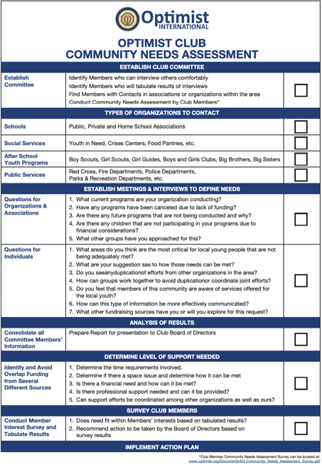
Community Assessment
Once you determine where an Optimist Club would be beneficial, you need to learn more about it.
  Demographics
    Schools in the area
    Service organizations
    Chamber of Commerce
  Visit the city
    Walk around and talk to people
  Find opportunities
  Identify a need and provide
Notes:
Analogy = find places to build and research all then determine the best place to begin. The other locations that can be built later in the year or next year. Share the information with others.

Slide 11

Research Analysis
Ok, you have gathered your information about the area(s) you are looking to build, you can conduct some simple analysis with your team.
Assess community
  Other non-profits in the area
  Opportunity
  Demographics
Key Stakeholders in the area
  Community Leaders
  School Leadership
Notes:
Assessing research is subjective but can be basic or detailed depending on the level of detail you want to gather and present to your team to decide about location, type of club and more.
Note: Analysis is to help me make an educated decision to help you be successful in building the new club.

Slide 12
Resources
Here are some resources that can help in researching a community.
  Chamber of Commerce in the city or township
  Community Needs Assessment click here
  City Data click here
  Canadian Statistics click here
  City Populations click here
  Great Schools click here
  U.S. Census click here
  Caribbean Data coming soon

Slide 13
Plan & Recruit
  “All you need is a plan, the roadmap, and the courage to press on to your destination.”
Earl Nightingale

Slide 14

Are You Ready?
An action plan will help you successfully build a new club and keep you and your team on track.
These include but not limited to:
  Who’s on your team?
  What type of club will you build?
  What is the timeline to building
  the new club?
  What are your milestones?
  Make a Recruiting Plan

Slide 15
Basic Project Plan
A basic project plan should be made to ensure you provide expectations to the team.
Task | Description
Who is on the team? | 2-3 builders
Sponsor Clubs | 1-2 clubs
Type of Club | Traditional, College, Sports
Location | Anywhere there is a need
Timeline | Start Date and Charter Date
Notification | New Club Building Chairs for District and Optimist International
Milestone | Communication to keep team, leaders updated and on track.

Slide 16
Resources
Here are some resources to help you along the way
Plan of Action click here
Membership Recruitment Kit click here
Membership Application click here
  Order applications from Optimist International Membership Team
Notes:
Mention all of these to help understanding.

Slide 17
Inform & Organize
  “With organization comes empowerment”
Lynda Peterson

Slide 18

Informational Gatherings
- Educate prospective Members about who we are, what we do, and how THEY can serve in your community.
-Held in-between recruiting activities to build Members and show them how they can be leaders through Optimism.

Slide 19
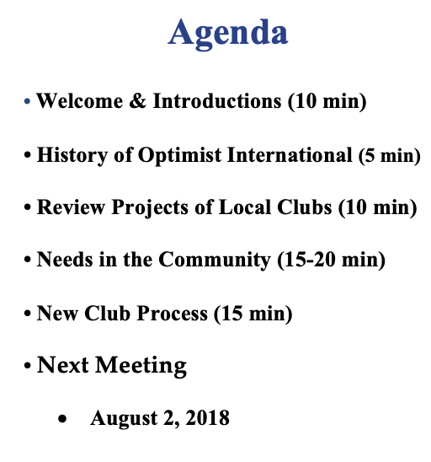
Lay the Foundation
Your first meeting of prospective members will be to be to gain knowledge, so you need an agenda and keep this meeting and additional meetings to specific time box of one hour.
Remember to respect everyone's time.

Slide 20
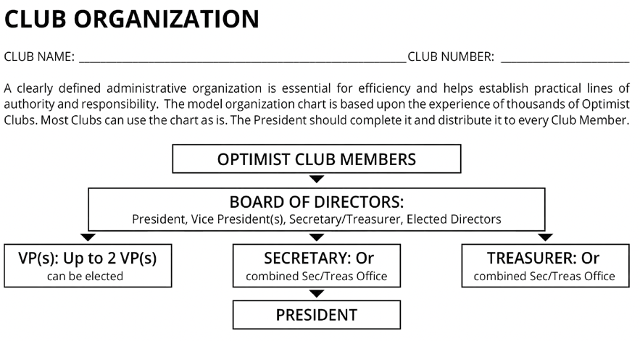
Sponsor Club
Pre-Organization Meeting
Meet with members of the New Club 10-14 days prior to the date set for the organizational meeting. This meeting should cover informal approval of the new Club’s bylaws, selection of officers, and determination of the date, place, time, and frequency of Club meetings.

Slide 21
Sponsor Club
Pre-Charter Requirements
Notify Optimist International two weeks in advance of the intent to organize a New Club. This allows for the scheduling of a field rep and completion of other administrative matters.
Send Optimist International the new Club fee one week prior to the organizational meeting to ensure timely recognition of the Club in the membership database.

Slide 22

It’s time to CHARTER!
Once you have 15 New Members or more you are ready to Charter and formally organize the Club.
To charter you will need to:
Complete the pre-organization structure
Schedule charter gathering with a minimum of nine
Members of the Club in attendance (secure location, send invites)
Confirm a Field Rep to ensure all
documentation is ready and
formally charter the New Club.

Slide 23
Resources
History click here
Projects click here
New Club Rules & Requirements click here
Dues & Fees click here
Club Officers coming soon

Slide 24
Follow-Up
  “Success comes from taking the initiative and following up or persisting”
Tony Robbins

Slide 25

Follow-Up Process
Just because the New Club is chartered, it doesn’t mean that you won’t need to do some follow-up.
A successful Club requires additional and continuous training.
There are three phases that need to be completed to ensure a successful New Club.

Slide 26
Orientation – Phase I
Orientation includes three phases and are outlined in the Follow-Up Program Handbook. The first is for the Sponsor Club assisting the New Club through three training meetings:
  Optimist International, District, and Zone Orientation
  Long- and short-term goals including community service, fundraising, and Club financial structure and budget
  Membership orientation
  Review New Club video series on Optimist Institute
Complete this phase within the first three months.

Slide 27
Orientation – Phase II
The first year includes periodic check-ins by the Sponsor Club and Lt. Governors to ensure a healthy Club
The follow-up program gives you details for these incremental check-ins.
  90 Day
  180 Day
  270 Day
  360 Day

Slide 28
Orientation – Phase III
This phase is completed during the 2nd year.
The follow-up process is an ongoing process that is a 2-year commitment and led by the District to ensure that each New Club becomes strong.
Who is responsible for follow-up?
All Builders of Excellence
Sponsor Club President
Sponsor Club Secretary
Sponsor Club Treasurer
Lieutenant Governor
Other Clubs in the Zone
Governor and Governor-Elect
New Club Building Chair
Membership Chair
Leadership Development Chair
International Vice President

Slide 29
Follow-Up Resources
New Club Follow-Up Program click here
Optimist Institute click here
New Club Follow-Up Report click here
Certificate of Completion click here

Slide 30
Summary

Slide 31

Building Successful New Clubs
Research & Discovery
Plan & Recruit
Inform & Organize
Follow-Up
New Club Building
Optimist International
4494 Lindell Blvd.
St. Louis, MO 63108

